Slide 1
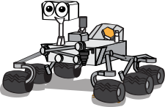
An Open Source Rapid Deployable DIY MARS Rover
Group A2
MARWIN
Team Members
Vyshak P P (VAS15CS113)
Mohamed Sahin V A (VAS15CS068)
Joe S Kolengaden (VAS15CS060)

Slide 2
Contents
Abstract
Problem Statement
Design

Slide 3
Introduction
Ever growing demand and developments in space exploration industry have inspired us to create MARWIN.
Rapid industrialization and entry of private firms in space industry have opened up new possibilities for startups.

Slide 4
Abstract: project background
The basic aim behind the project is to address the need of open source projects in space industry.
The MARWIN rover is designed to be modular and customizable according to various explorational needs.
The basic use of MARWIN will be to avail rapid deployable rover solutions in human exploration of other planets.

Slide 5
Problem statement:
The working of space rover cannot be exhibited to the public directly and it is because of high maintenance costs.
There is a lack of open-source projects that support space exploration and related technology.
There is no available prototype or even design for rapid deployable modular rovers.

Slide 6
Design
The design principle of MARWIN is logically divided into 3*3*3 like Rubik’s Cube design approach.
We use Rocker Bogie mechanism for traversing through rough terrain.
We provide any of the scientific equipment in this prototype.
Atmospheric content Sensor : Which enables us to detect the presence of different types of Gases.
Life detecting robotic system : Which detects the presence of biological life form.

Slide 7
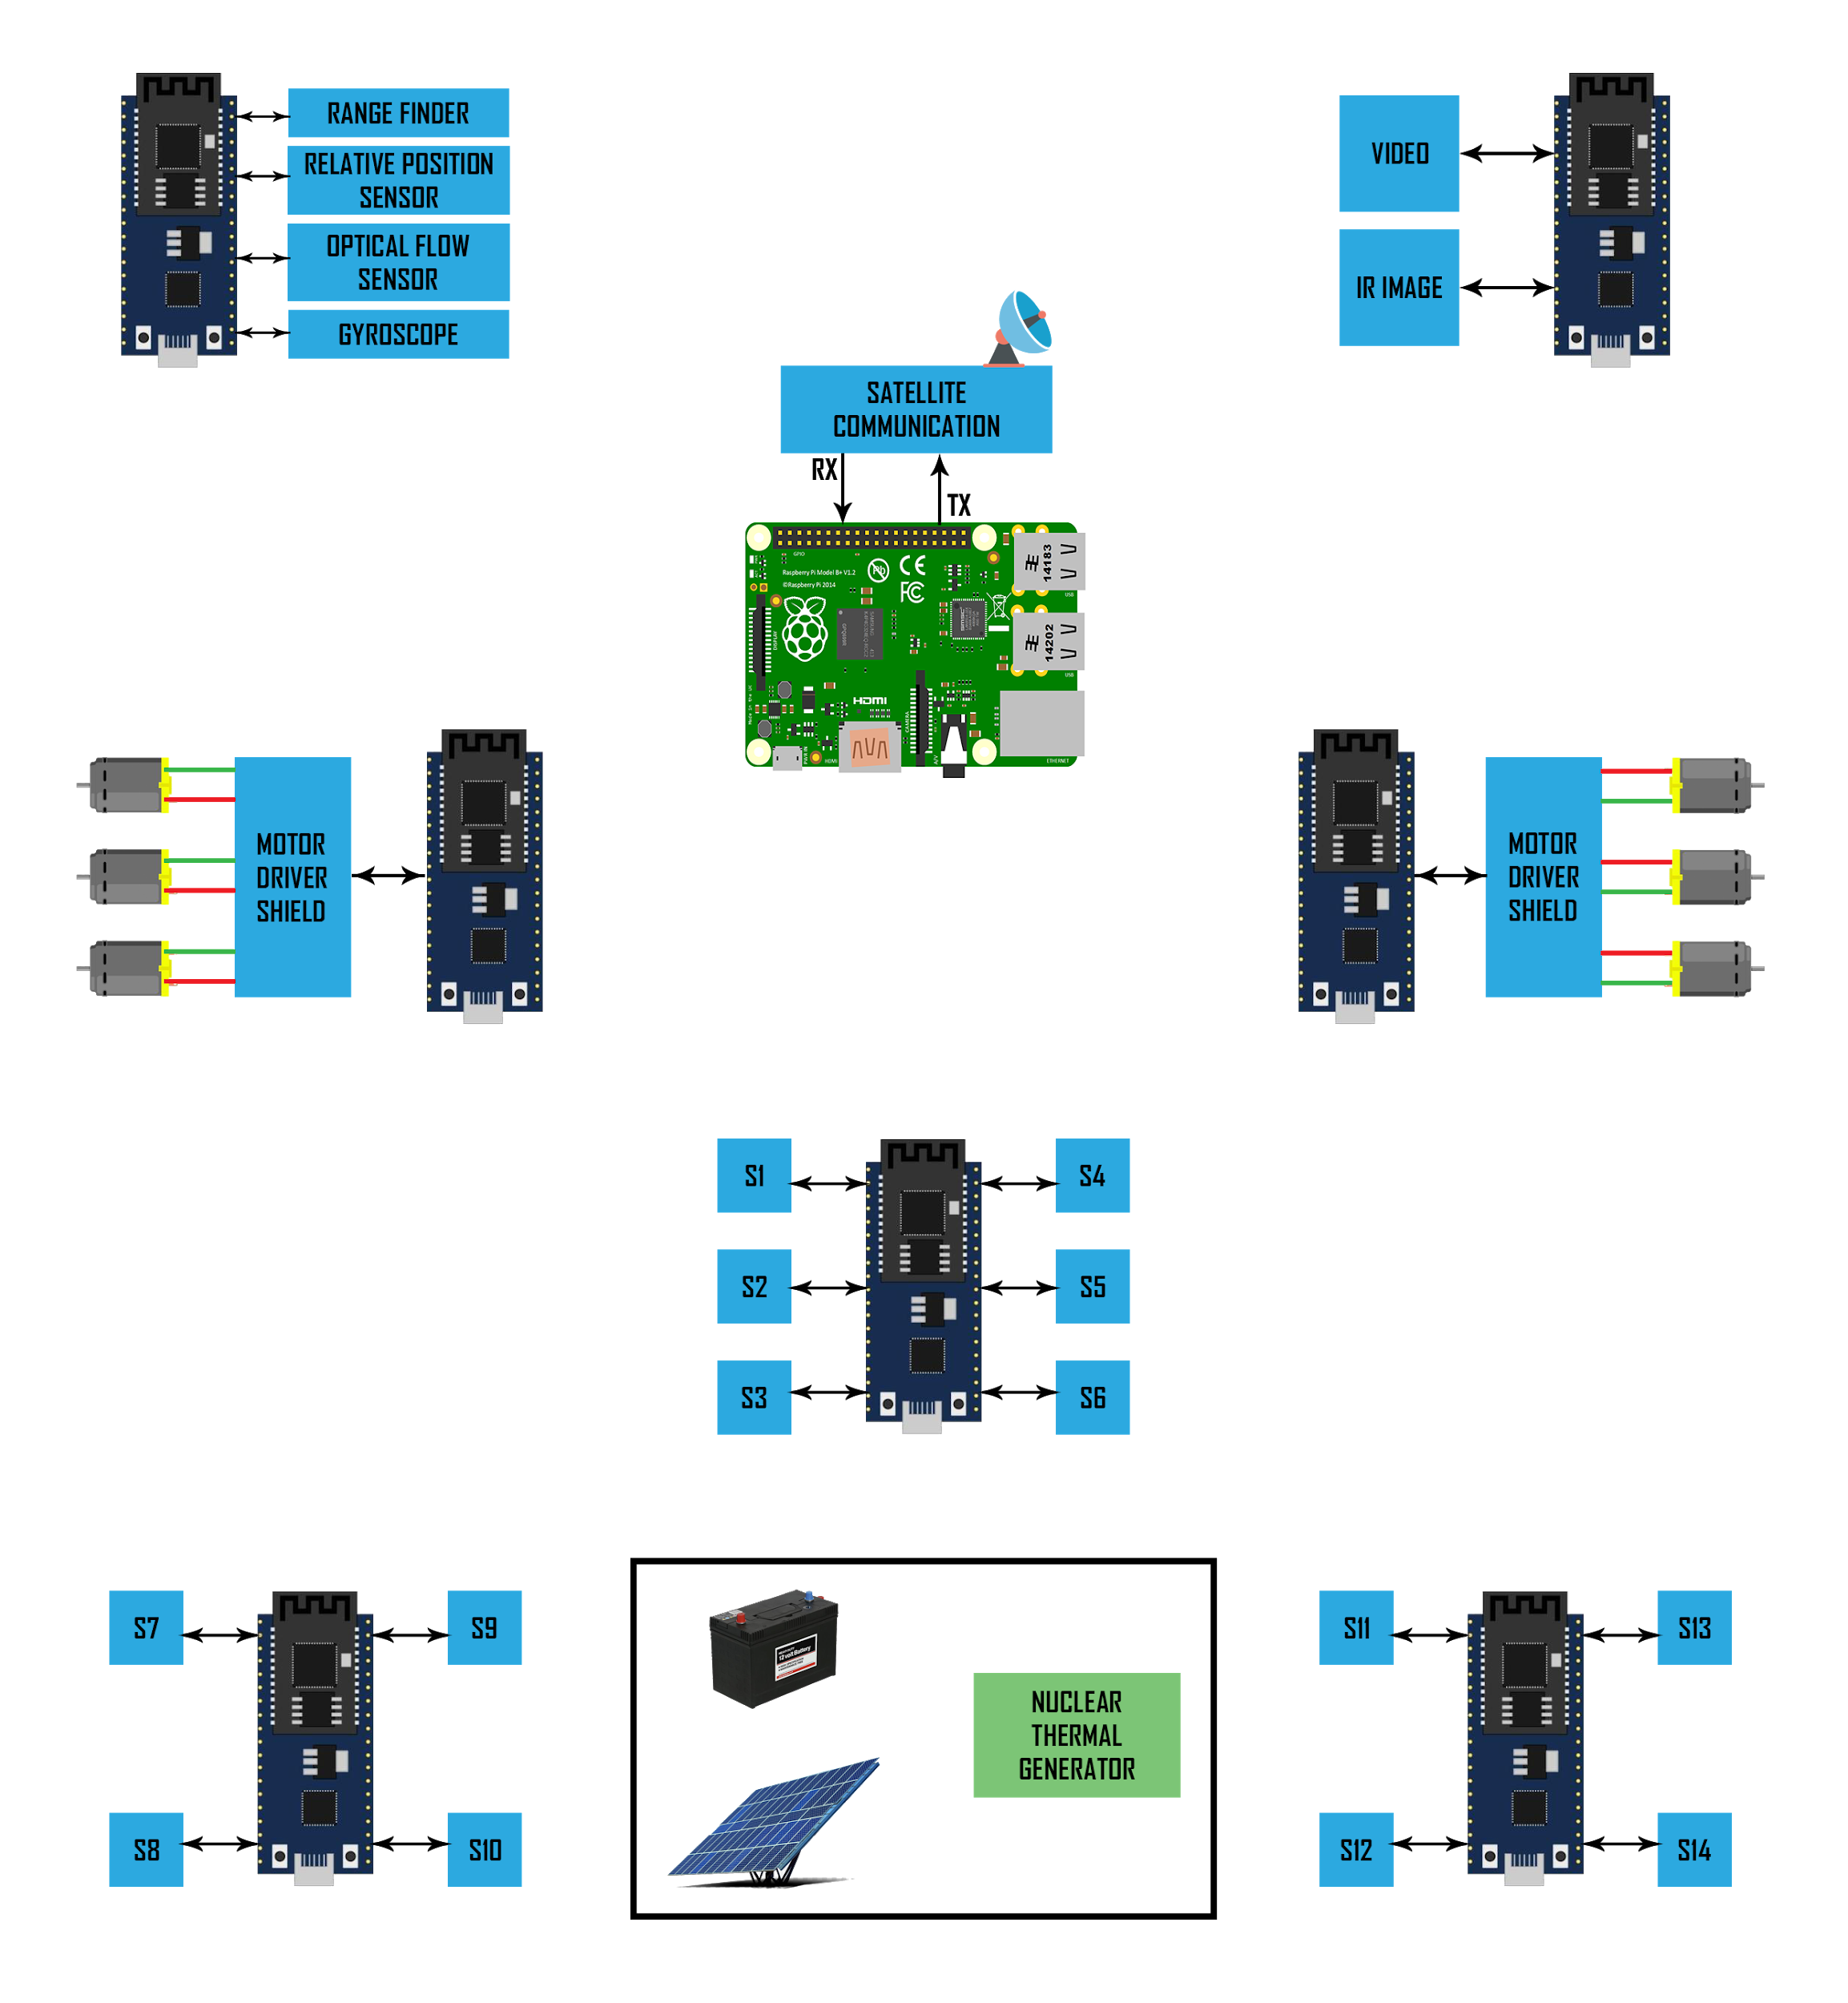
Architecture

Slide 8
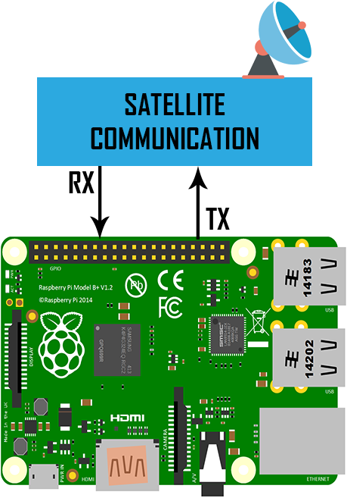
Raspberry Pi 3 B+
It acts as the brain (Motherboard).
Buffers all data in the internal server (Database).

Slide 9
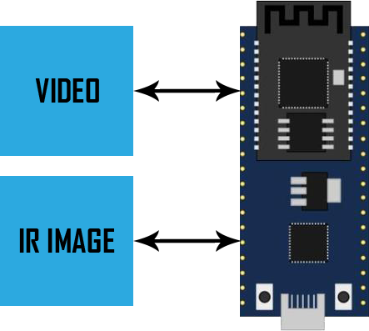
Live Analysis

Slide 10
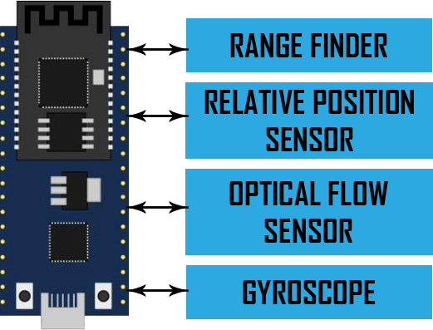
Navigation Block

Slide 11
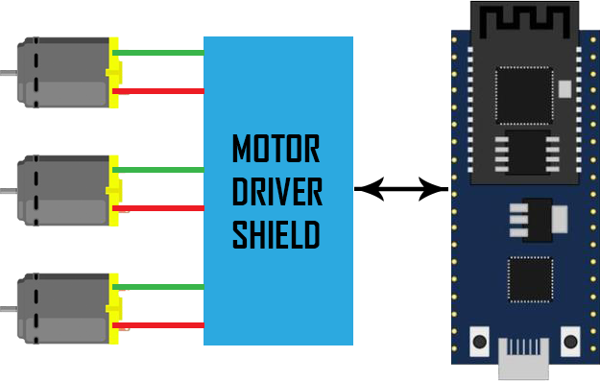
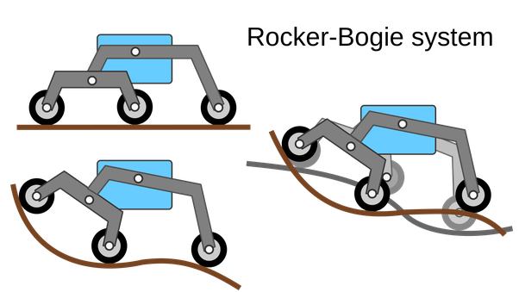
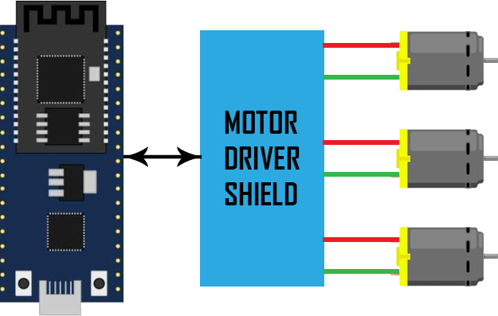
Left Wheel & Right Wheel

Slide 12
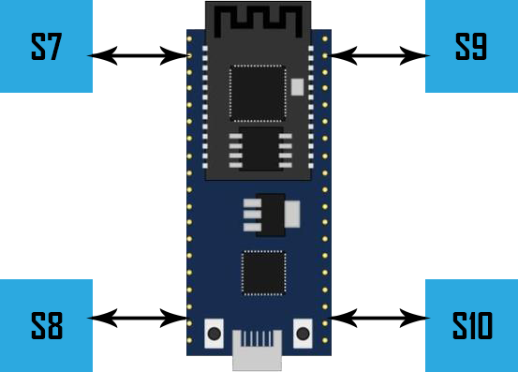
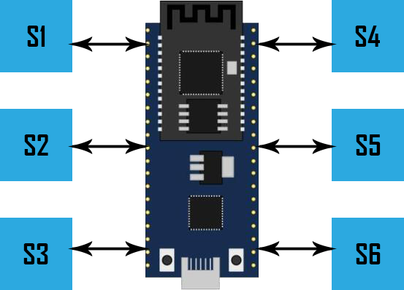
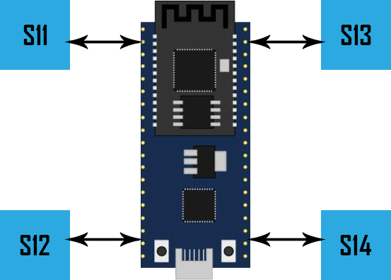
Sensor Cluster 1, 2 & 3

Slide 13

Power management block

Slide 14
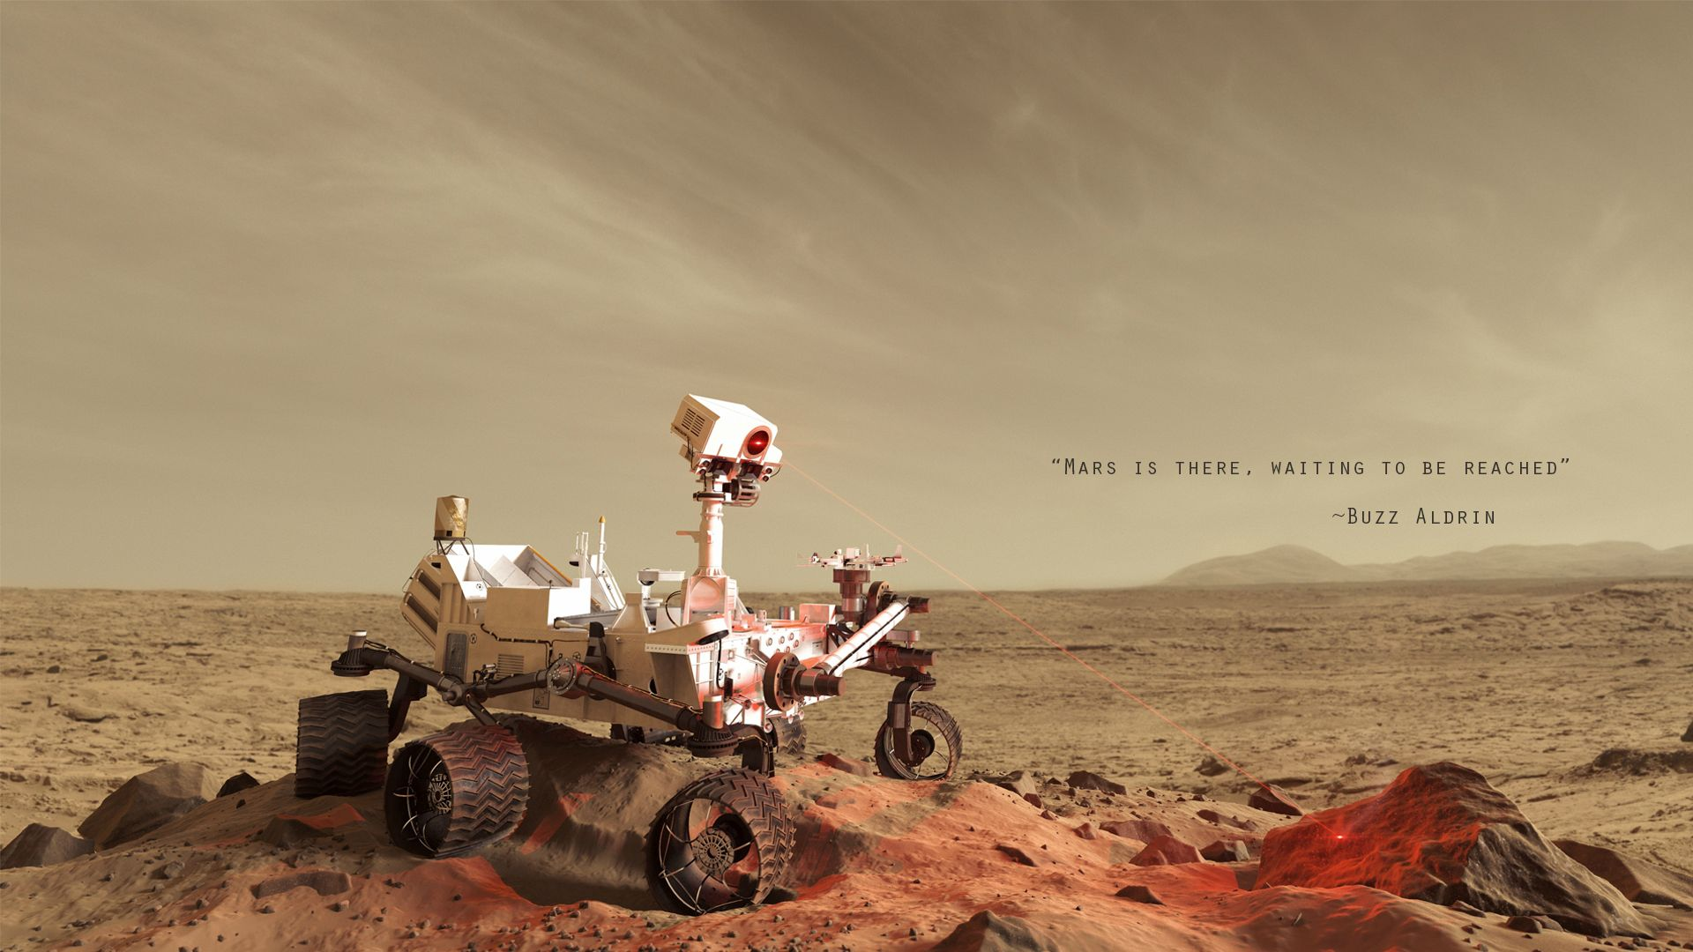
Thank you !!

